Slide 1
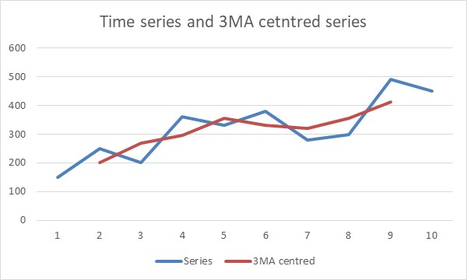
Time series data - Short and medium term forecasts
Moving Averages?
Handling errors?
Forecasting?
The aim of this chapter is to provide the reader with a set of tools which can be used in the context of time series analysis and extrapolation.

Slide 2
Introduction
Short-term and medium-term forecasting methods require understanding of relatively simple and intuitive concepts, such as moving averages and exponential smoothing.
Part 1 Moving averages
After we introduced a concept of a moving average, we will learn how to use this concept as a short-term forecasting technique. If we wanted to use the same technique for medium-term forecasts, then certain modifications are needed, and we will introduce double moving averages to explain how to achieve this.
Part 2 Exponential smoothing
As a more sophisticated alternative to moving averages, we will introduce exponential smoothing. This method can also be used as a short-term and a medium-term approach to forecasting. We will explain how both types of forecasts are executed using this technique.

Slide 3
Learning objectives
On completing this unit, you should be able to:
Understand moving averages.
Be able to forecast using single and double moving averages.
Understand exponential smoothing.
Be able to forecast using single and double exponential smoothing.
Calculate a measure of error for the model fit to the data set.
Construct a prediction interval.
Produce seasonal short to medium range forecasts.
Be able to apply Holt-Winters method to seasonal mid-range forecasts.
Solve problems using the Microsoft Excel and SPSS.

Slide 4
Part 1 Moving averages (1/2)
Short-term and medium-term forecasting techniques are all based around some sort of moving averages, or smoothed values where past errors play role in forecasting.
One way or the other, both sets of techniques are essentially “smoothing” the original time series.
What do we mean by this?
We mean that the time series that is created by using one of these methods to fit the historical values, will in its appearance be smoother than the original time series. It will have fewer dramatic ups and downs and it will appear as if someone “ironed” the original time series.

Slide 5
Moving averages (2/2)
Smoothing the original time series and treating this smoothed time series as an approximation of the original time series, or the fit, means that we are eliminating some random elements from the time series.
Just like in the previous chapter, we assumed that the long-term forecast is the trend, plus some random variations, here we are looking not for a trend, but for a moving average.
In fact, it can be either a moving average, or exponentially smoothed value.
Everything beyond that is also treated as a residual. So, in principle we kept the same philosophy as in the previous chapter, but we are substituting the trend values with the moving average values, or exponentially smoothed values.

Slide 6
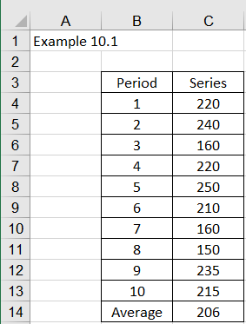
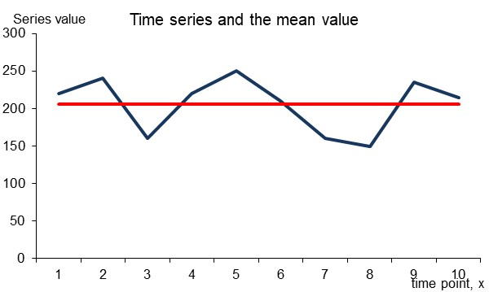
Simple moving averages (1/6)
To understand moving averages, we must remind ourselves of some of the basic properties of the mean value, or an average, in the context of time series analysis. We’ll use a very short and artificial time series just for the illustration purposes.
Example 11.1
A very short time series in Figure 11.1 has an average value of 206. The above average value represents the series well, because the series flows very much horizontally.
Figure illustrates this graphically. The average of 206 is shown as a horizontal line that runs across the time series.

Slide 7
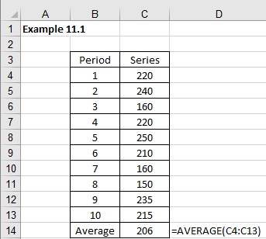
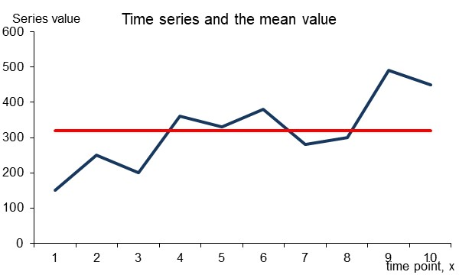
Simple moving averages (2/6)
As we know, the above sample time series can be called a stationary time series. This implies that an average is a very good predictor of a stationary time. If we know the average (the mean value, for example), then we can easily predict the next value in the series by using the mean value.
However, if the series was moving upwards, or downwards, we have a non-stationary time series. In this case this average value would not be the best representation of the series. In this case a much more realistic representation would be a moving average.

Slide 8

Simple moving averages (3/6)
Moving averages are dynamical averages that change in accordance with the number of periods for which they are calculated. A general formula for moving averages is given by equation (11.1).
In equation (11.1), t is the time period and N is the number of observations in the interval taken into the calculation. The above equation can be simplified and expressed as equation (11.2).
This means that the moving average for M₃ is calculated as:

Slide 9

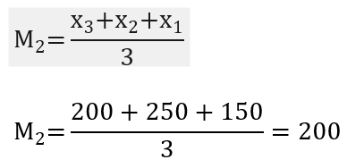
Simple moving averages (4/6)
For the first example (see Figure 11.1)
In this case, the moving average value for the first three observation is placed in the third period, i.e. at the end of the period for which it is calculated.
However, sometimes you will see the following equation:
This is called a centred moving average. Nothing wrong with that. If we had an even number of observations in the interval, we would have to calculate the average value between the two middle observations, so it is customary to take the odd number of observations in the moving average interval.

Slide 10
Simple moving averages (5/6)
It is a convention to place the moving average value either aligned with the last observation from the moving average interval, or to centre it in the middle of the moving average interval. For these purposes, we recommend that, if appropriate, the moving average interval consists of odd number of observations.
Another way to express the equation (11.2) is as follows:
In other words, if we do not know the value of the first observation in the moving average interval, we can still estimate the current moving average from the previous value of the moving average, plus the other two values from the interval.

Slide 11

Simple moving averages (6/6)
If we had 5 elements in the moving average interval (N=5) and, for example, we tried to estimate the 8th moving average value in the series, the equation (11.3) would look as follows:
Although this might appear to be useless fact here, you will see why we mentioned it when we discuss exponential smoothing. The key point here is that the current value of the moving average can be extracted from the previous value of the moving average, plus some combination of the actual historical values of the time series.
To standardise the notation, we will use an abbreviation MA for moving averages, or SMA (single, or simple moving averages). If you see 3MA or 5MA, this means: single moving averages for the interval of 3 or 5 observations respectively.

Slide 12
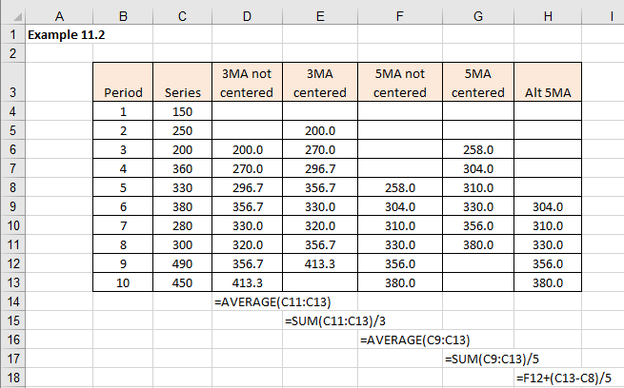
Example 11.2 – Excel (1/2)
We created another short time series and calculated different moving averages

Slide 13
Example 11.2 - Excel (2/2)
To illustrate how the time series and 3MA centred series look likewe are showing the original time series and the 3MA time series.

Slide 14
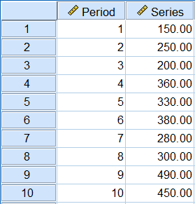
Example 11.2 – SPSS (1/7)
SPSS provides a standard function for calculating centred moving averages. Figure 11.7 contains the same time series as in Figure 11.5.

Slide 15
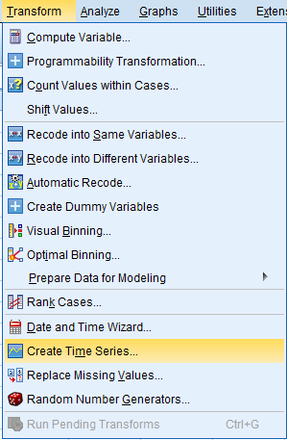
Example 11.2 – SPSS (2/7)
To calculate moving averages, we need to create a new time series.
Select Transform > Create Time Series

Slide 16
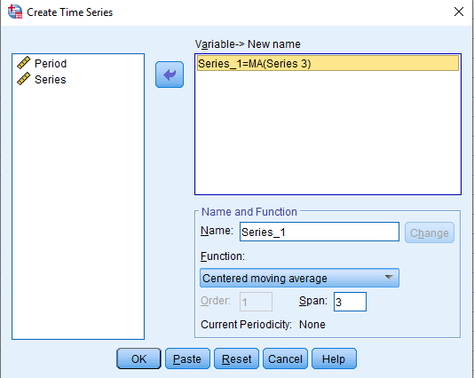
Example 11.2 – SPSS (3/7)
This brings a dialogue box as illustrated.
Use the drop-down menu Function to choose Centered moving average.
In the Span entry box type 3.
Transfer Series to the Variable -> New name box
Click OK

Slide 17
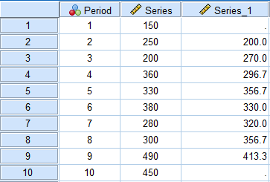
Example 11.2 – SPSS (4/7)
SPSS output
This creates a new series, where Series_1 represents the 3-point centered moving average.

Slide 18
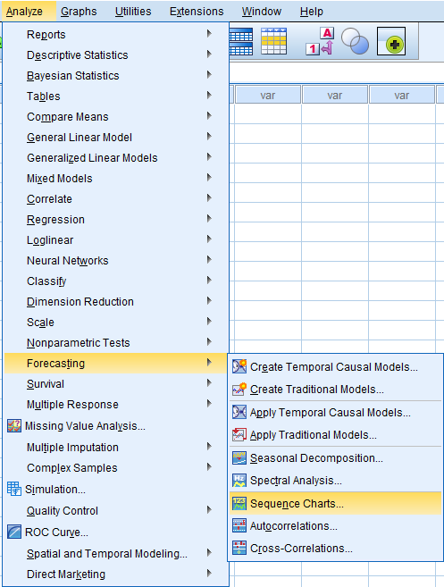
Example 11.2 – SPSS (5/7)
To chart both time series (the original time series and a newly created 3MA centred time series) onto the same chart.
Select Analyze
Select Forecasting
Select Sequence charts

Slide 19
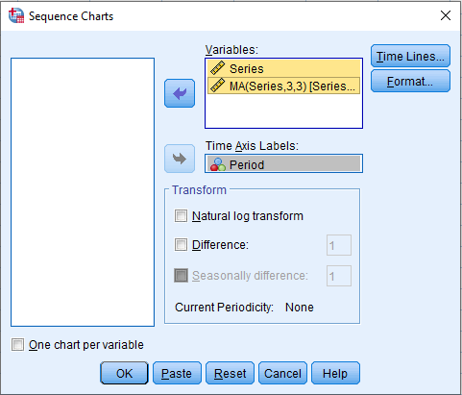
Example 11.2 – SPSS (6/7)
Move Periods to Time Axis Labels and Series and MA(Series,3,3) to variables
Click OK

Slide 20
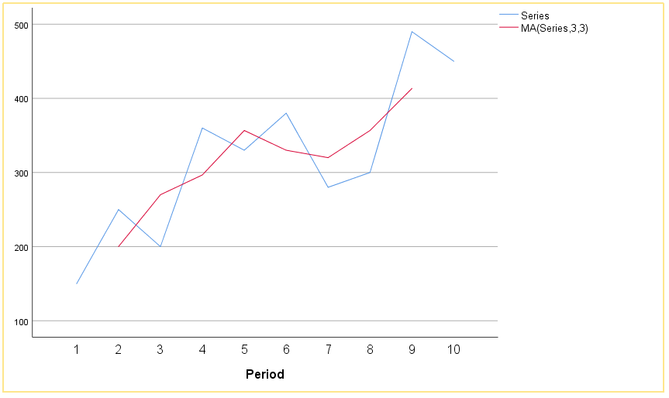
Example 11.2 – SPSS (7/7)
SPSS output

Slide 21
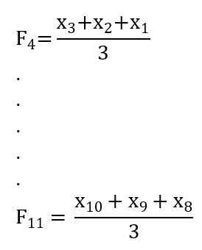
Short-term forecasting with moving averages (1/3)
Now we know how to create moving averages, the question is: how do we use them as a forecasting tool? The answer is very simple: we just shift the moving average by one period in the future and this becomes our forecast. Equation (11.2) can be re-written as a forecast in the following way:
In other words, the moving average for the first three periods (if we are using 3 moving average periods), becomes a forecast for the fourth period:

Slide 22
Short-term forecasting with moving averages (2/3)
If we take the data from Example 11.2, then according to equation (11.4) the forecasts for one period ahead are as follows:
Period | Series | 3MA forecasts | Equations
1 | 150
2 | 250
3 | 200
4 | 360 | 200.0 | =(150+250+200)/3
5 | 330 | 270.0 | =(250+200+360)/3
6 | 380 | 296.7 | =(200+360+330)/3
7 | 280 | 356.7 | =(360+330+380)/3
8 | 300 | 330.0 | =(330+380+280)/3
9 | 490 | 320.0 | =(380+280+300)/3
10 | 450 | 356.7 | =(280+300+490)/3
11 |  | 413.3 | =(300+490+450)/3
Table 11.1 illustrates the forecast at time point 11 is 413.3.

Slide 23
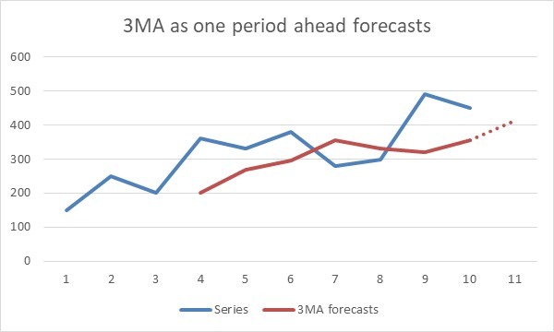
Short-term forecasting with moving averages (3/3)
If we present the results in a graphical form, then our forecast for one period ahead is as illustrated

Slide 24
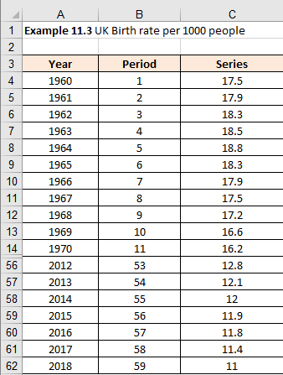
Example 11.3 (1/3)
Let us now use a little longer time series and see how to use the moving averages function in Excel for forecasting purposes.
Figure shows the UK birth rate per 1000 people from 1960-2018.
In total 59 observations (rows 15-55 are hidden) and the graph.

Slide 25
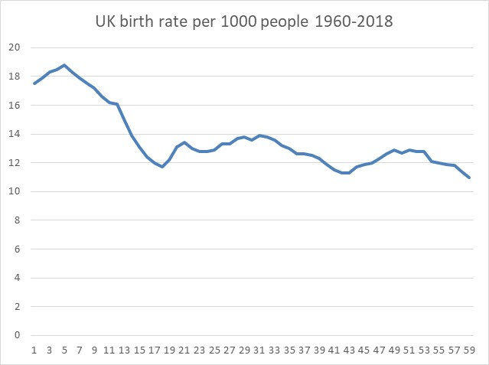
Example 11.3 (2/3)

Slide 26
Example 11.3 (3/3)
We have several ways to apply moving averages in Excel:
Using Format Trendline
Centered moving average.
Uncentered moving average.
Excel Data Analysis moving average method.

Slide 27
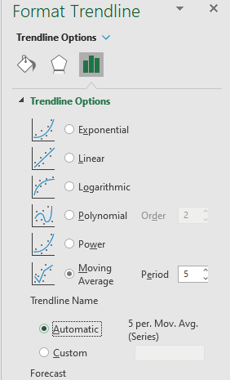
Example 11.3 – Excel Solutions for moving average method (1/5)
Format Trendline method
We right click on the time series in a graph, which invokes a dialogue box with several options included.
Click on Add Trendline
We then click on the option called “Moving Average” and change the number of periods to 5 as illustrated.

Slide 28
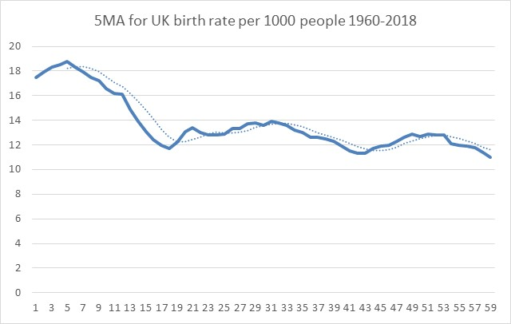
Example 11.3 – Excel – Format Trendline (2/5)
Excel will automatically chart the moving averages from the last observation in the period specified (in this case five). If we selected a 5-period moving average, then the moving average function would start from observation five.
This is equivalent to using the Excel Data > Data Analysis > Moving Average method
Figure 11.19

Slide 29
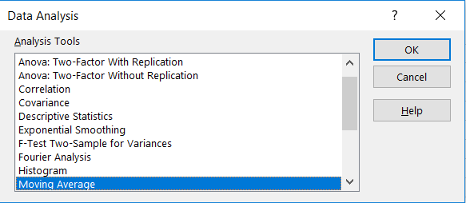
Example 11.3 – Excel Data Analysis solution (3/5)
Excel Data > Data Analysis > Moving Averages method
The second method is to use the Data > Data analysis > Moving Average option.
Figure 11.20

Slide 30
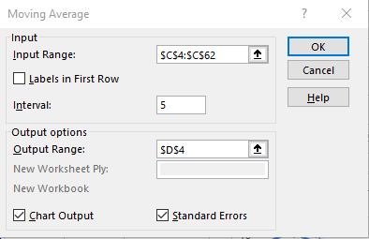
Example 11.3 – Excel Data Analysis solution (4/5)
Select the range, i.e. cells C4:C62, which is where our time series resides, and we selected Interval of 5, which is the number of moving averages we decided to use.
Further down in the same dialogue box, we selected the output to start in cell I4.
We also selected the Chart Output and Standard Errors.

Slide 31
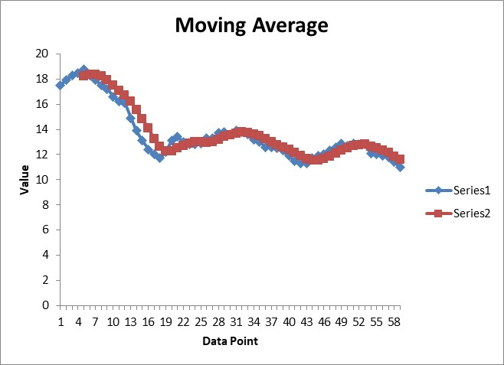
Example 11.3 – Excel Data Analysis solution (5/5)

Slide 32
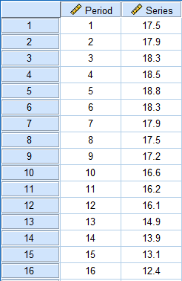
Example 11.3 – SPSS solutions (1/5)
To calculate moving averages, we need to create a new time series.
Select Transform > Create Time Series

Slide 33
Example 11.3 – SPSS solutions (2/5)
SPSS Centered moving average
This brings a dialogue box
Use the drop-down menu Function to choose Centered moving average.
Transfer Series to the Variable -> New name box
In the Span entry box type 5.
Click on Change.
Click OK

Slide 34
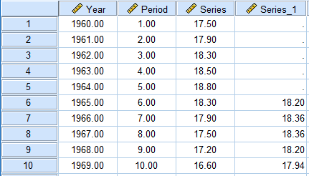
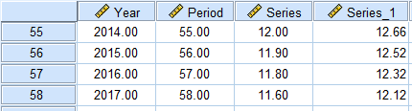
Example 11.3 – SPSS solutions (3/5)
This creates a new series, where Series_1 represents the 5-point prior moving average.
Rows 11 – 54 hidden
Uncentered moving average
As we already know, all we need to do is to shift the moving average calculations, as produced by Excel, by one observation, assuming uncentered moving averages.
Please note that the SPSS prior moving average method provides the forecast values.
The forecast for t = 8 is 18.36, forecast for t = 58 is 12.12. Please note that SPSS does not provide the forecast for t = 59.

Slide 35
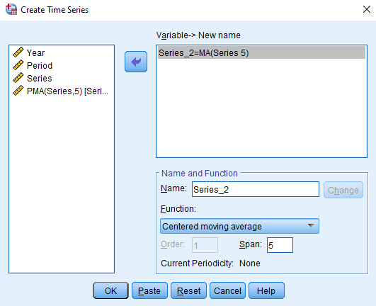
Example 11.3 – SPSS solutions (4/5)
SPSS centered moving average
This brings a dialogue box
Use the drop-down menu Function to choose Centered moving average.
Transfer Series to the Variable -> New name box
In the Span entry box type 5.
Click on Change.

Slide 36
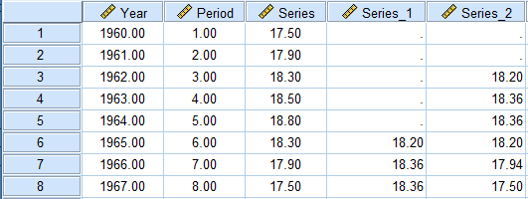
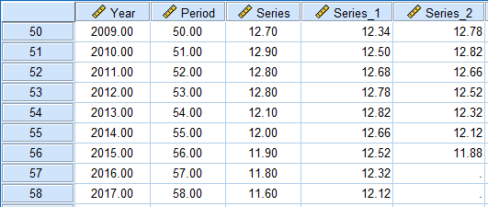
Example 11.3 – SPSS solutions (5/5)
This creates a new series, where Series_1 represents the 5-point prior moving average.
Rows 9 – 49 hidden
Centered moving average
If we have a centered moving average, then we shift down the 5MA series by 3 moving average observations.
For example, forecast at t = 8 is 18.36 and the forecast at t = 58 is 12.12.
Please note that SPSS does not provide the forecast for t = 59.

Slide 37
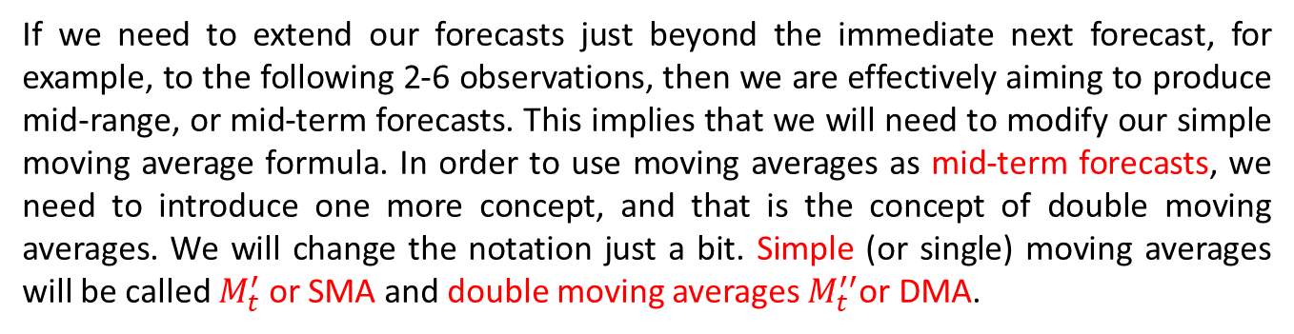
Mid-range forecasting with moving averages (1/3)
If we need to extend our forecasts just beyond the immediate next forecast, for example, to the following 2-6 observations, then we are effectively aiming to produce mid-range, or mid-term forecasts. This implies that we will need to modify our simple moving average formula. In order to use moving averages as mid-term forecasts, we need to introduce one more concept, and that is the concept of double moving averages. We will change the notation just a bit. Simple (or single) moving averages will be called $M_{t}^{′}$ or SMA and double moving averages $M_{t}^{′′}$or DMA.
In the same fashion as moving averages represent a ‘rolling’ average of the actual observations in the series, we could equally imagine a ‘rolling’ average of these moving averages, or, double moving averages. Single moving averages are defined by equation (11.1) and double moving averages are:
In other words, a moving average of the moving averages.

Slide 38

Mid-range forecasting with moving averages (2/3)
Using single and double moving averages, we can construct a dynamic intercept and a dynamic slope coefficient, which will move and fluctuate as the original time series moves. These two coefficients are calculated as follows:
Where N in the denominator is the number of moving averages in the interval. These two coefficients enable us to calculate forecasts that dynamically change as the time series changes. The formula is:

Slide 39
Mid-range forecasting with moving averages (3/3)
The equation (11.8) will produce forecasts just one period ahead. We said that we were looking for a method that can forecast further into the future. Well, the answer is now very simple. If we need to extend forecasts m periods into the future, then the equation for double moving average (DMA) forecasts becomes:
Where m is the number of future periods (1, 2, 3, ..., m).
Equation (11.9) looks identical as a simple regression equation or a simple trend extrapolation. However, there are two major differences:
Both simple regression and simple trend extrapolation use the fixed value of a and b. With double moving averages (DMA) equation, the coefficients a_{t} and b_{t} are dynamic and they change from period to period.
The second difference, a simple trend extrapolation had a variable x, which represented time periods, starting from 1 and proceeding as consecutive numbers until the end of the time series.
The forecasts were the continuation of the same number stream (if the time series has 20 observations, the value of x for the future calculations is 21, 22, 23, …).
With DMA, the value of m applies to the future periods, and m always starts with 1 (the future values of m are: 1, 2, 3, …).

Slide 40
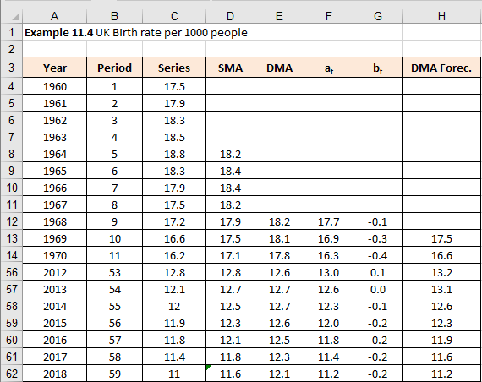
Example 11.4 (1/4)
We’ll use the same data as in Example 11.3.
Figure 11.27 summarises the whole procedure (as before rows 15 = 55 are hidden).
We are using 5-period moving averages.

Slide 41
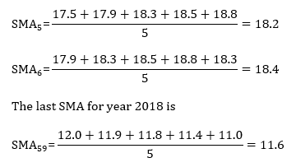
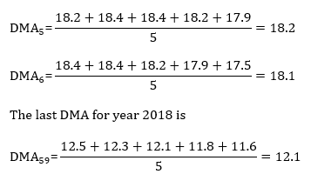
Example 11.4 (2/4)
To calculate the first two SMA for year 1964 and 1965, for example, we use equation (11.1):
DMAs for the same years are calculated using equation (11.5) as:

Slide 42
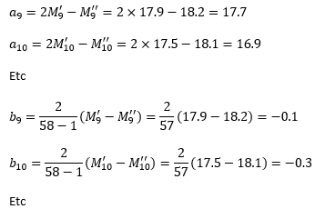
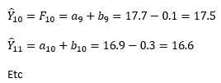
Example 11.4 (3/4)
Coefficients a_{t} and b_{t} are calculated using equations (11.6) and (11.7). The examples for time periods 9 and 10 are:
One step forecasts ${\hat{Y}}_{t+1}$ are calculated using equation (11.8). Again, we show here just periods 10 and 11:

Slide 43
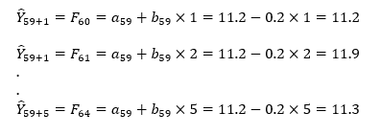
Example 11.4 (4/4)
When we reach the last observation, the value of SMA₅₉=11.6, DMA₅₉=12.1, a₅₉=11.2, b₅₉=-0.2.
To calculate m-forecasts ahead, we use equation (11.9):

Slide 44
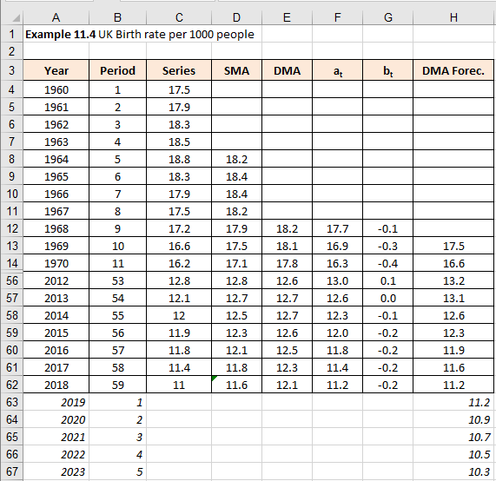
Example 11.4 – Excel (1/3)
To implement these calculations in Excel is very easy, as shown in Figure 11.28.

Slide 45
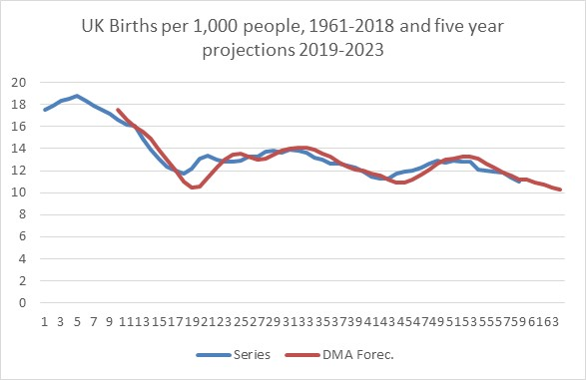
Example 11.4 – Excel (2/3)
In this example we used 5-period single moving averages (5SMA) and five period double moving averages (5DMA). They are shown in columns D and E. Columns F and G calculate a_{t} and b_{t}, using equations (11.6) and (11.7). The first part of equation (11.7) has the term 2/(N-1). As N represents number of observations in the moving average interval (5 in this case), this translates into 2/(5-1)=2/4=1/2.
The past forecasts, or the DMA fit of the existing time series is given in cells H13:H62. However, the future forecasts are given in cells H63:H67 and they were calculated using equation (11.9). The chart in Figure 11.29 shows the result, i.e. the graph of the original time series and its DMA forecasts.

Slide 46
Example 11.4 – Excel (3/3)
As we can see, because the values of the coefficients a_{t} and b_{t} are dynamically calculated, the historical DMA forecasts values are ‘mimicking’, or emulating, the movements of the original time series.
Unfortunately, once we have reached the last observation in the series, these coefficients are “frozen” and all the future extrapolated values are linear.
Clearly, the reason they are linear (straight line) is because the formula for DMA forecasts is a linear formula.

Slide 47
Example 11.4 – SPSS
SPSS does not offer a ready-made solution for DMA, so we will skip this section.

Slide 48
Conclusion
This presentation provided a set of tools which can be used to analyse time series data:
Moving averages
Handling errors
Forecasting

